Slide 1
AMUDHA PRIYA MP 711721244002 III B.Tech CSBS KGiSL Institute of Technology
CAPSTONE PROJECT
FRAUD DETECTION USING ANN
Final Project
Presented By
3/21/2024 Annual Review

Slide 2
PROJECT TITLE
Fraud detection in financial data by using Artifical Neural Network
3/21/2024 Annual Review

Slide 3


AGENDA
1. Problem Statement
2. Project Overview
3. End Users
4. Solution and Value Proposition
5. The Wow Factor in Your Solution
6. Modelling
7. Results
3/21/2024 Annual Review

Slide 4

PROBLEM STATEMENT
Financial fraud poses a significant challenge for businesses and institutions, leading to substantial financial losses and reputational damage.
Utilizing historical financial transaction data, we'll build a predictive model using an artificial neural network (ANN) in Python. The model will be trained and tested on the dataset to accurately identify fraudulent transactions.
Detecting fraudulent activities within financial data is crucial to maintaining the integrity of transactions and protecting stakeholders' interests.
3/21/2024 Annual Review

Slide 5

PROJECT OVERVIEW
The objective of this project is to develop a robust system for fraud detection within financial data.
By leveraging advanced data analytics and machine learning techniques, the aim is to identify patterns and anomalies indicative of fraudulent behavior, thereby enabling proactive intervention and mitigation.
3/21/2024 Annual Review

Slide 6

WHO ARE THE END USERS?
The end users of this fraud detection system could be financial institutions such as banks, credit card companies, or online payment platforms. These institutions are typically responsible for detecting and preventing fraudulent activities within their systems to protect their customers and maintain trust in their services
Additionally, regulatory bodies and law enforcement agencies may also use such systems to monitor and investigate suspicious financial transactions.
3/21/2024 Annual Review

Slide 7

YOUR SOLUTION AND ITS VALUE PROPOSITION
Our solution employs a multi-faceted approach to fraud detection, incorporating data preprocessing, feature engineering, and machine learning algorithms.
The value proposition of our solution lies in its ability to enhance the overall security and integrity of financial transactions, thereby safeguarding stakeholders' interests and minimizing potential losses due to fraudulent activities
By analyzing historical transaction data and identifying patterns associated with fraudulent activities, the system can flag suspicious transactions in real-time, enabling timely intervention and prevention of fraudulent behavior.
By deploying our system, organizations can mitigate risks, streamline operations, and maintain trust with their customers and partners.
3/21/2024 Annual Review

Slide 8

THE WOW IN YOUR SOLUTION
One of the key distinguishing features of our solution is its adaptability and scalability. By leveraging cutting-edge machine learning algorithms and continuously learning from new data, the system can evolve and adapt to emerging fraud patterns and tactics.
Its machine learning capabilities enable continuous evolution to combat emerging fraud tactics, ensuring ongoing protection.
Furthermore, our solution offers a user-friendly interface and seamless integration with existing financial systems, making it accessible and easy to deploy across various organizations and industries.
3/21/2024 Annual Review
8

Slide 9
MODELLING
The modeling phase involves data preprocessing, feature selection, and the implementation of machine learning algorithms such as supervised learning classifier
The models are trained on labeled datasets containing both genuine and fraudulent transactions, allowing them to learn patterns indicative of fraudulent behavior.
Evaluating model performance using a separate test dataset, calculating metrics like accuracy.
3/21/2024 Annual Review
9

Slide 10
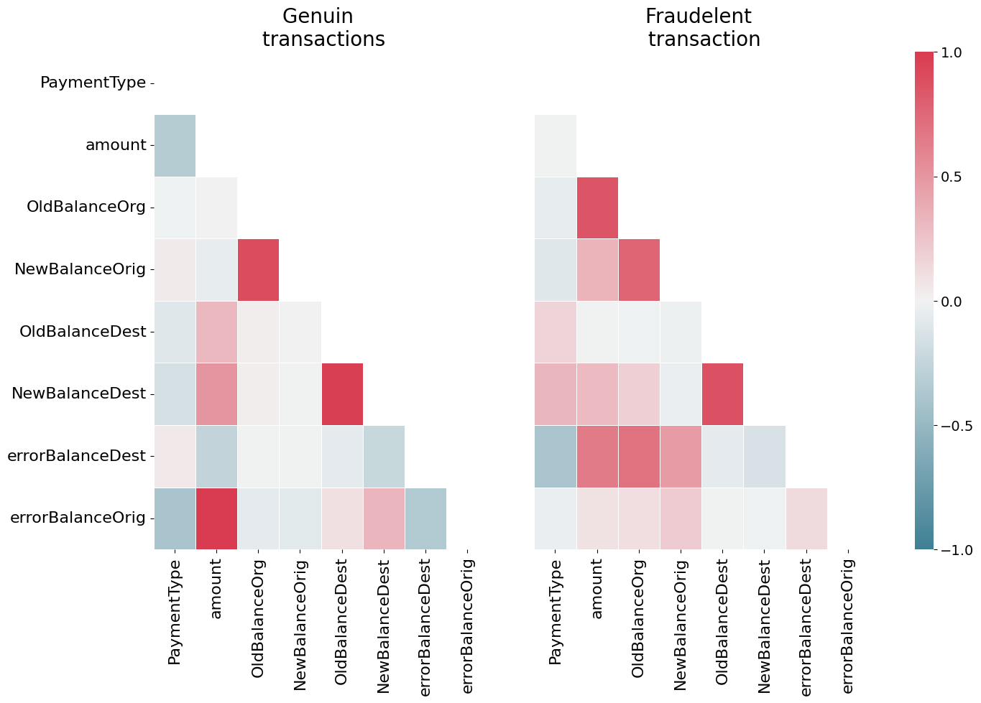
RESULTS
https://drive.google.com/file/d/1IrPQWM3xEQwQ4SzJk_tm11NFAVxCirzu/view?usp=sharing
3/21/2024 Annual Review
10

